Slide 1
XG (OR) EXTREME GRADIENT BOOSTING

Slide 2
XGBoost (eXtreme Gradient Boosting) regression is a powerful and widely-used machine learning algorithm for predicting continuous numeric values. It is an optimized implementation of the gradient boosting framework, which builds an ensemble of decision trees sequentially, with each new tree learning to correct the errors (residuals) made by the previous ones.

Slide 3
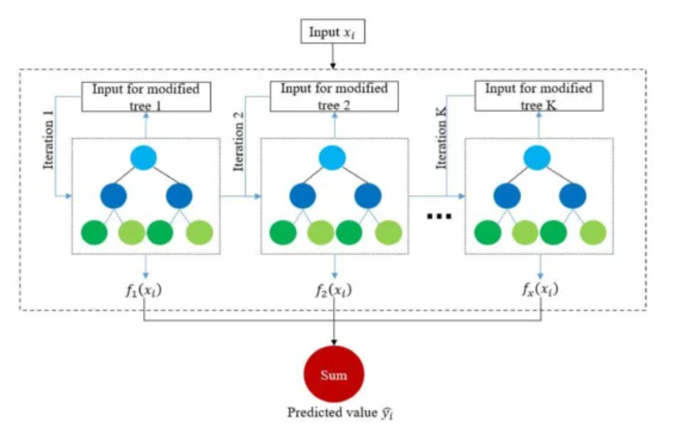

Slide 4
How It Works:
The fundamental principle of XGBoost regression is to build trees iteratively, with each new tree attempting to correct the prediction errors (residuals) of all previous trees.
Initial Prediction: The process starts with an initial prediction, often the mean of the target variable.
Calculate Residuals: The errors (residuals) between the actual values and the current predictions are calculated.
Build a New Tree: A new decision tree is trained to predict these residuals, not the actual target values.
Update Predictions: The predictions from the new tree are scaled by a learning rate (eta) and added to the ensemble's current predictions, gradually improving accuracy.
Repeat: Steps 2-4 are repeated until the residuals are minimized or a stopping criterion is met. The final prediction is a weighted sum of all the trees' outputs.

Slide 5
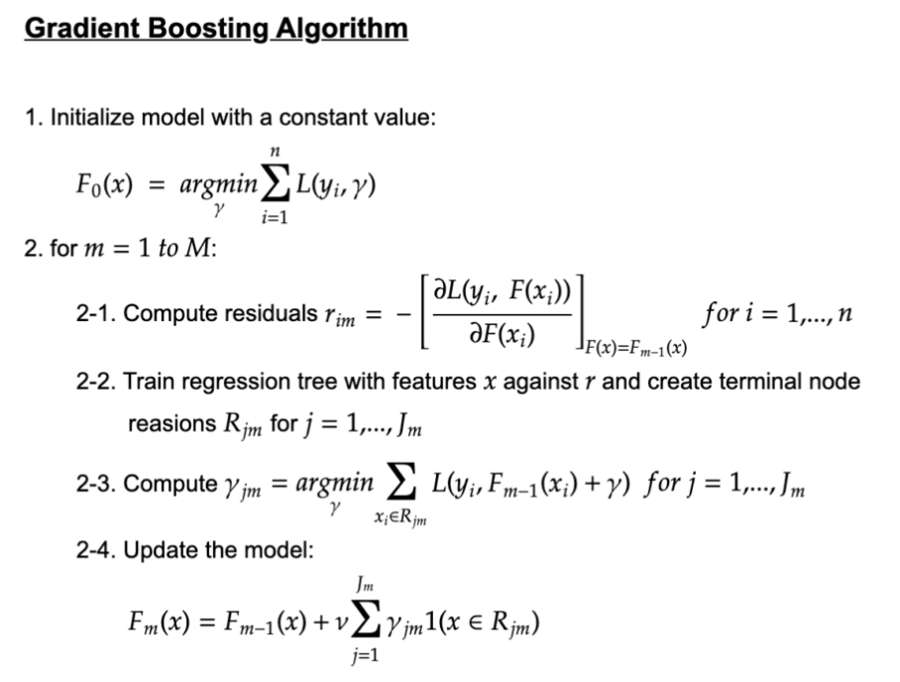
FORMULAS:

